Slide 1
Module – A The 8085 Microprocessor DIVYA SINGH

Slide 2
8085
MICROPROCESSOR ARCHITECTURE &
PIN CONFIGURATION
^{Addressing Modes}
^{Register Organization}
^{Instruction Set}
^{Types} of operations

Slide 3
8085 Microprocessor
It is an 8-bit microprocessor designed by Intel in 1977 using NMOS technology.
8085 uses a single +5-volt(V) power supply.
The 8085 is supplied in a 40-pin DIP package.
Address up to 64k locations.(consist 16 Address lines)
Word Size-: 8 bits (It can process 8 bits at a time.(consist 8 data lines)
It can run at a maximum frequency of 3 MHz.

Slide 4
The 8085: CPU Internal Structure
The internal architecture of the 8085 CPU is
capable of performing the following operations:
Store 8-bit data (Registers, Accumulator)
Perform arithmetic and logic operations (ALU)
Test for conditions (IF / THEN)
Sequence the execution of instructions
Store temporary data in RAM during execution

Slide 5
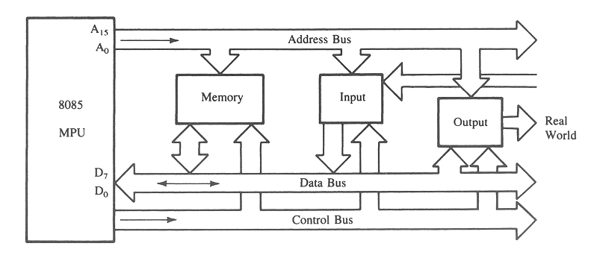
The 8085 Bus Structure
The 8-bit 8085 CPU (or MPU – Micro Processing Unit) communicates with the other units using a 16-bit address bus, an 8-bit data bus and a control bus.

Slide 6
The 8085 Bus Structure
Address Bus
Consists of 16 address lines: A₀ – A₁₅
Operates in unidirectional mode: The address bits are always sent from the MPU to peripheral devices, not reverse.
16 address lines are capable of addressing a
total of 2¹⁶ = 65,536 (64k) memory locations.
Address locations: 0000 (hex) – FFFF (hex)

Slide 7
The 8085 Bus Structure
Data Bus
Consists of 8 data lines: D₀ – D₇
Operates in bidirectional mode: The data bits are sent from the MPU to peripheral devices, as well as from the peripheral devices to the MPU.
Data range: 00 (hex) – FF (hex)
Control Bus
Consists of various lines carrying the control signals such as read / write enable, flag bits.

Slide 8
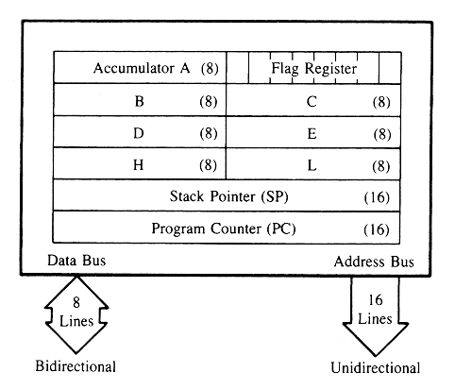
Registers
General purpose Registers
Temporary Registers
Special Purpose Register
16 Bit Registers

Slide 9
The 8085: CPU Internal Structure
Registers
Six general purpose 8-bit registers: B, C, D, E, H, L
They can also be combined as register pairs to
perform 16-bit operations: BC, DE, HL
Registers are programmable (data load, move, etc.)
Accumulator
Single 8-bit register that is part of the ALU !
Used for arithmetic / logic operations – the result is always stored in the accumulator.

Slide 10
The Flags register
S
Z
AC
P
CY
Indicate the result of condition tests.
Conditional operations (IF / THEN) are executed based on the condition of these flag bits.
S-sign flag
The sign flag is set if bit D7 of the accumulator is set after an arithmetic or logic operation.
Z-zero flag
Set if the result of the ALU operation is 0. Otherwise is reset.
AC-Auxiliary Carry
This flag is set when a carry is generated from bit D3 and passed to D4 . This flag is used only internally for BCD operations.
P-Parity flag
After an ALU operation if the result has an even no of 1’s the p-flag is set. Otherwise it is cleared. So, the flag can be used to indicate even parity.
CY-carry flag
CY = carry is set when result generates a carry. Also a borrow flag.

Slide 11
Question
If the 8085 adds 87H and 79H, specify the contents of the accumulator and the status of the S, Z, and CY flag?

Slide 12
Program COUNTER (PC) AND STACK POINTER (SP)
These are two 16-bit registers used to hold memory addresses.
PC:
The function of the PC is to point to the memory address from which the next byte is to be fetched.
When a byte (machine code) is being fetched, the program counter is incremented by one to point to the next memory location.
SP:
It points to a memory location in R/W memory, called the stack.
The beginning of the stack is defined by loading a 16-bit address in the stack pointer.
The PC will automatically update when calling to /returning from Subroutines.

Slide 13
The ALU
In addition to the arithmetic & logic circuits, the ALU includes the accumulator, which is part of every arithmetic & logic operation.
Also, the ALU includes a temporary register used for holding data temporarily during the execution of the operation. This temporary register is not accessible by the programmer.

Slide 14
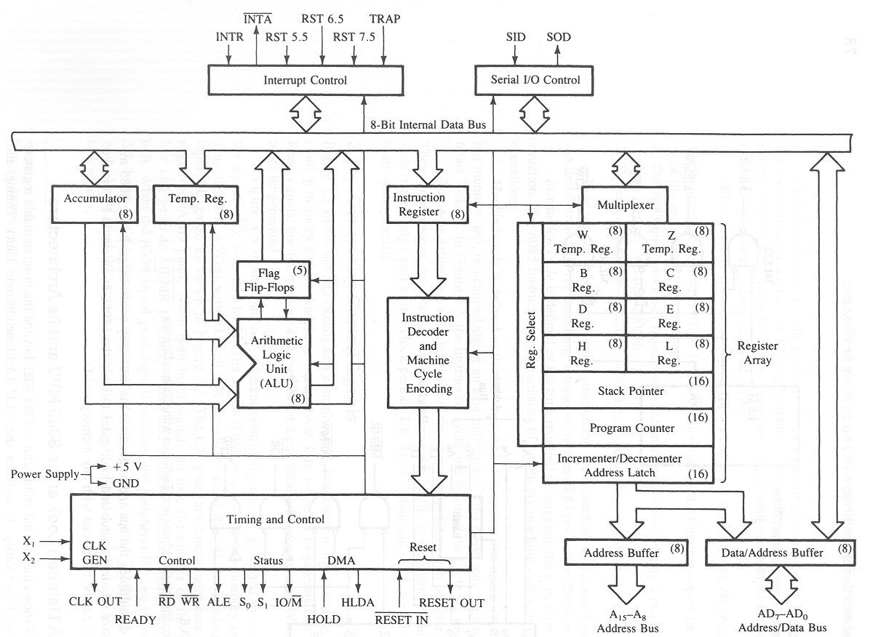
8085 Functional Block Diagram

Slide 15
Functional Blocks
Registers
ALU
Instruction Decoder
Address Buffer
Address/Data Buffer
Increment/ Decrement Address Latch
Serial I/O Control
Timing and control circuitry
Interrupt Control

Slide 16
Instruction Decoder and Machine cycle Encoder
This accepts a bit pattern from instruction register, decode it and gives the decoded information to control logic unit.
It contains:
What operation to be performed?
Who will perform this?
How many bytes the instruction contains?
Notes: 8085 Microprocessor executes seven types of Machine cycle.

Slide 17
Address Buffer/ Data Buffer
Address buffer:
This is an 8 bits unidirectional buffer used for address lines.
These are used to drive higher order address bus.
Address/ Data buffer:
This is an 8 bits bidirectional buffer used for address and data lines.
These are used to drive low order address and Data bus.

Slide 18
Increment/ decrement Address Latch
16 bits Register
Used to increment and decrement address contents of PC, HL, BC, DE and SP.

Slide 19
Serial IO
The data transferred on data bus is parallel data but certain condition required serial data.
8085 uses SID and SOD pins for data under software control by serial I/O block.
It uses two special instruction RIM and SIM for it.

Slide 20
Timing & Control Unit
Control all internal and external circuits.
Operates with reference to clock signal.
Accepts information from instruction decoder and generates micro steps.
Synchronizes all data transfers.

Slide 21
Interrupt Control
Accepts different interrupt request inputs. Such as TRAP, RST5.5, 6.5, 7.5 and INTR.
Inform control logic to take action for valid interrupt request and acknowledge by INTA signal.
Software Interrupt
Hardware Interrupt

